Slide 1
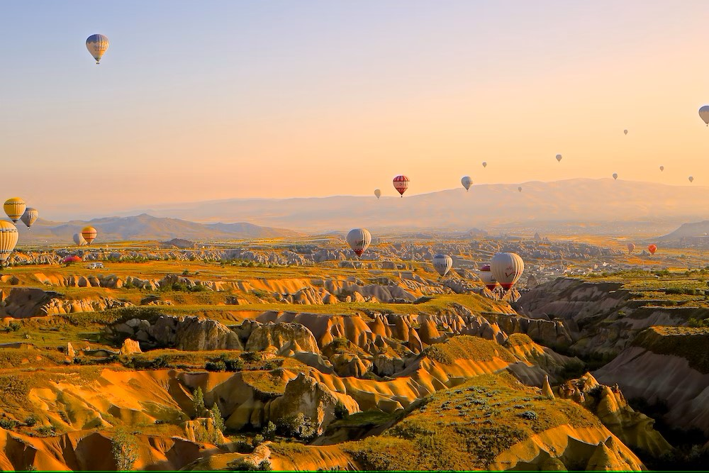
Travel Booking Website

Slide 2
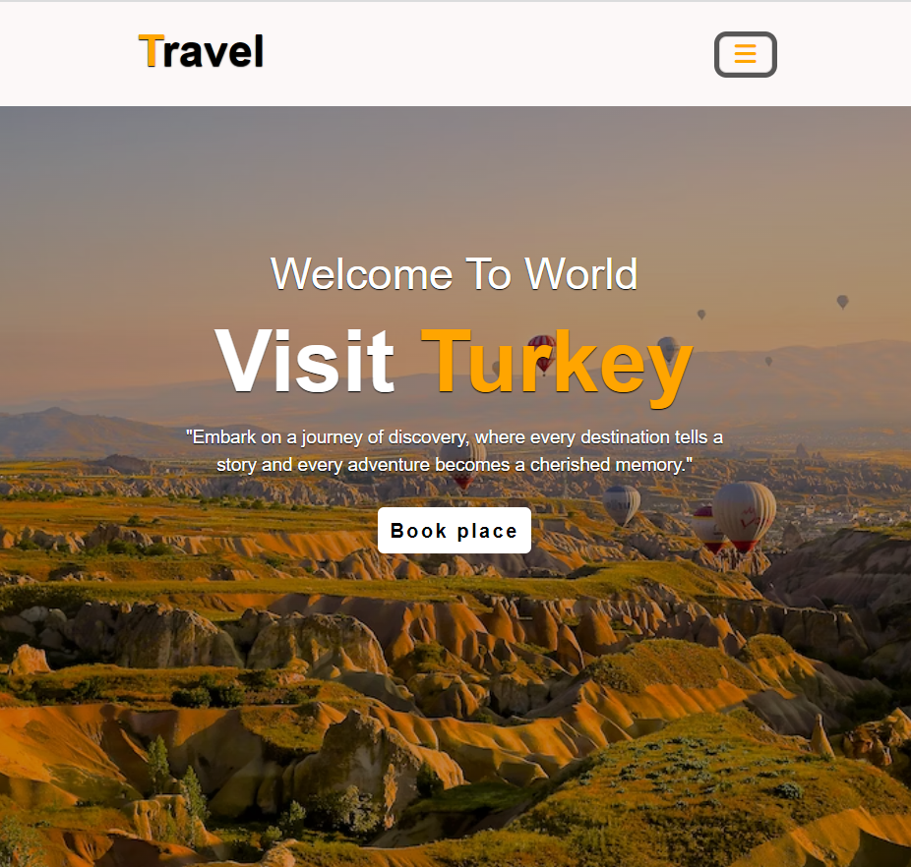
Objective
“TO provide a secure and enriching travel experience for our customers, Promoting safe tourism through meticulously crafted packages that not only prioritize safety measures but also deliver immersive cultural experiences, scenic exploration, and memorable adventures. Our goal is to inspire confidence in travelers by ensuring their well-being while creating bespoke packages that showcase the beauty of diverse destinations.”

Slide 3

Technical Details
This Website is designed using HTML , CSS and Bootstrap.
The website is made flexible and responsible with the use of media queries.
Ensure a mobile-friendly experience using responsive design principles.
This website can run easily in any browsers.

Slide 4


Pages of the Website
Home Page
Book
Packages
Services
Gallery
About

Slide 5
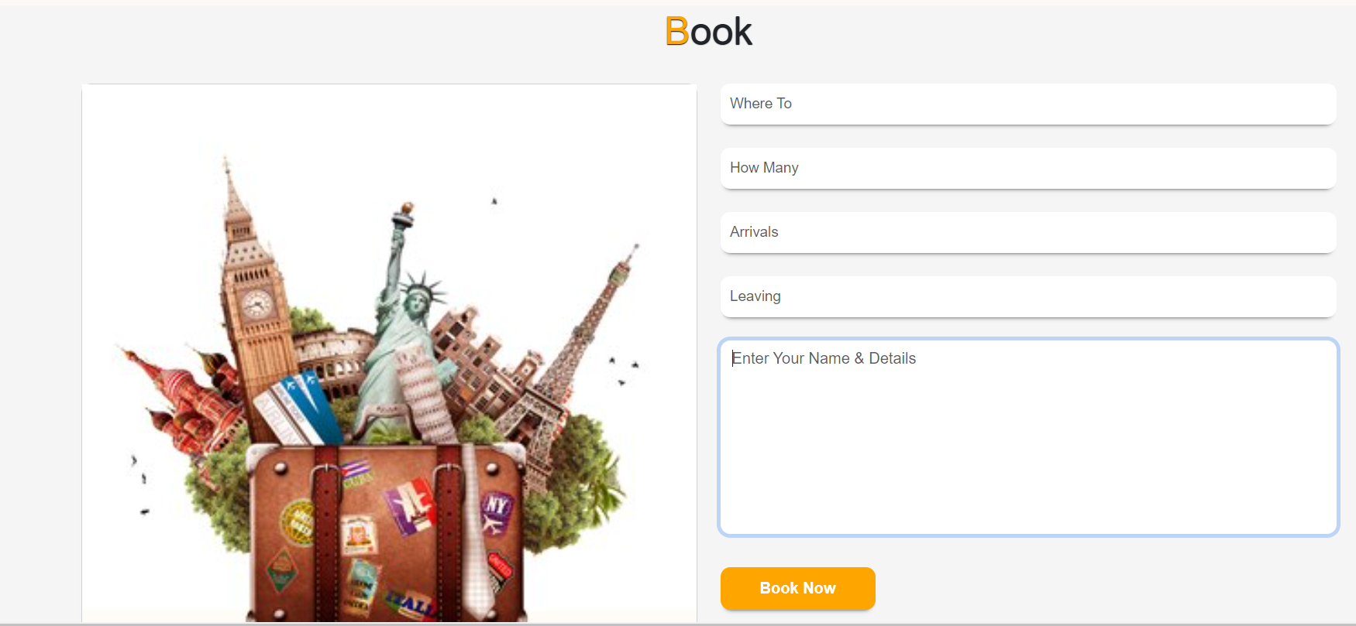
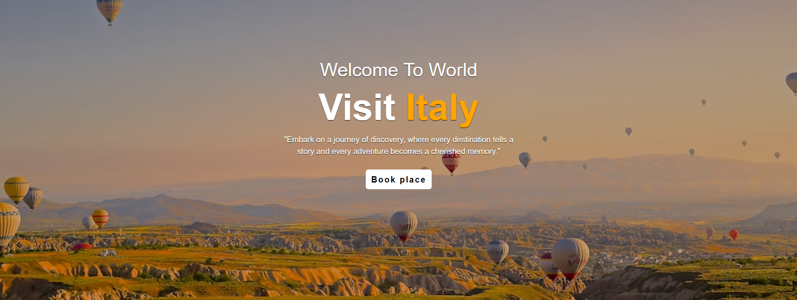
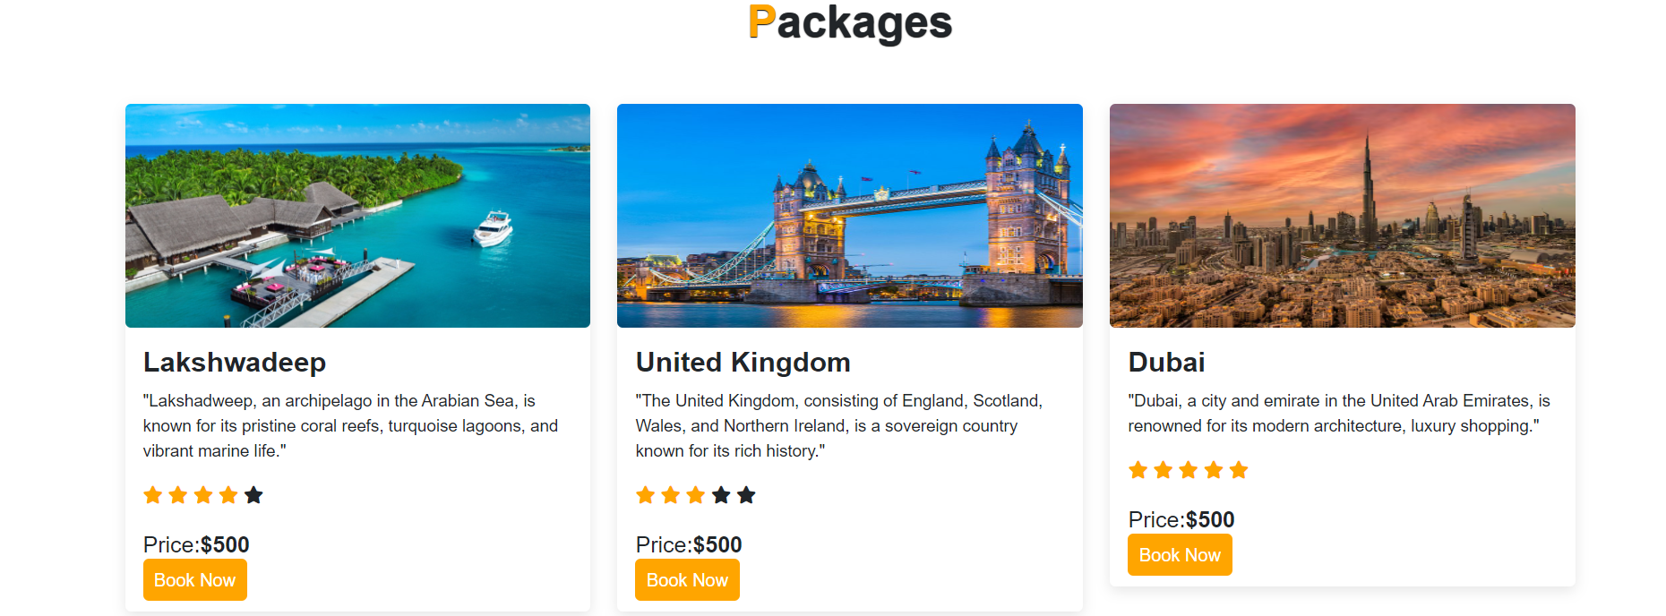
Website Pages

Slide 6
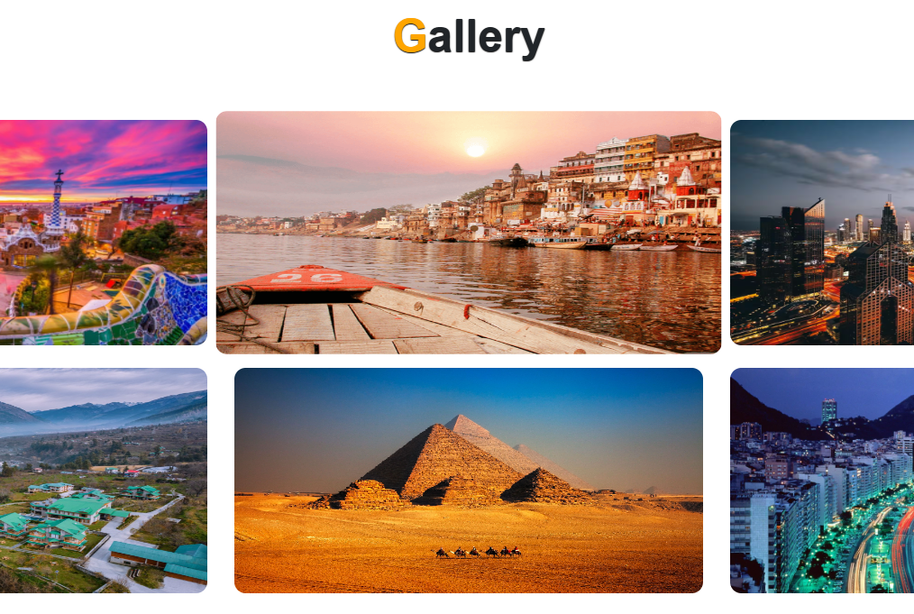
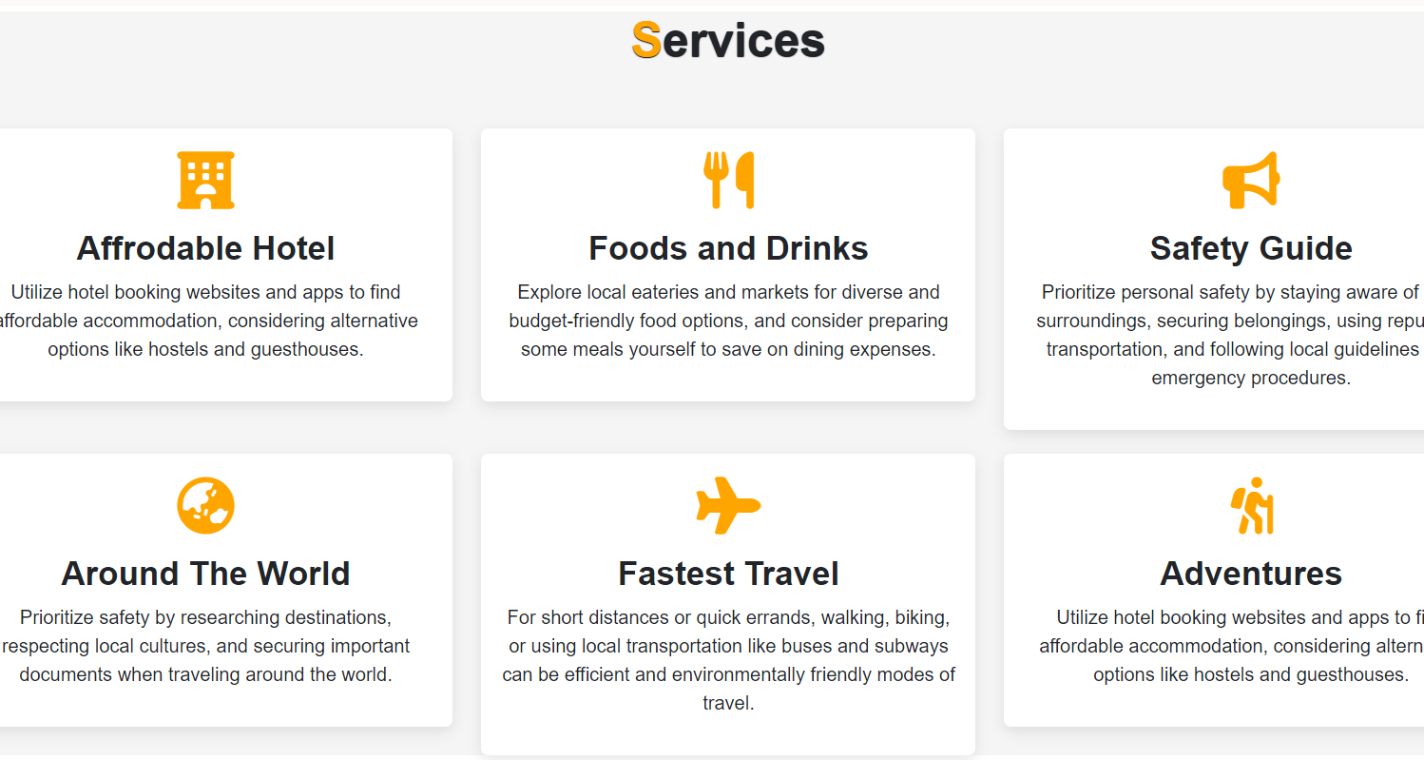
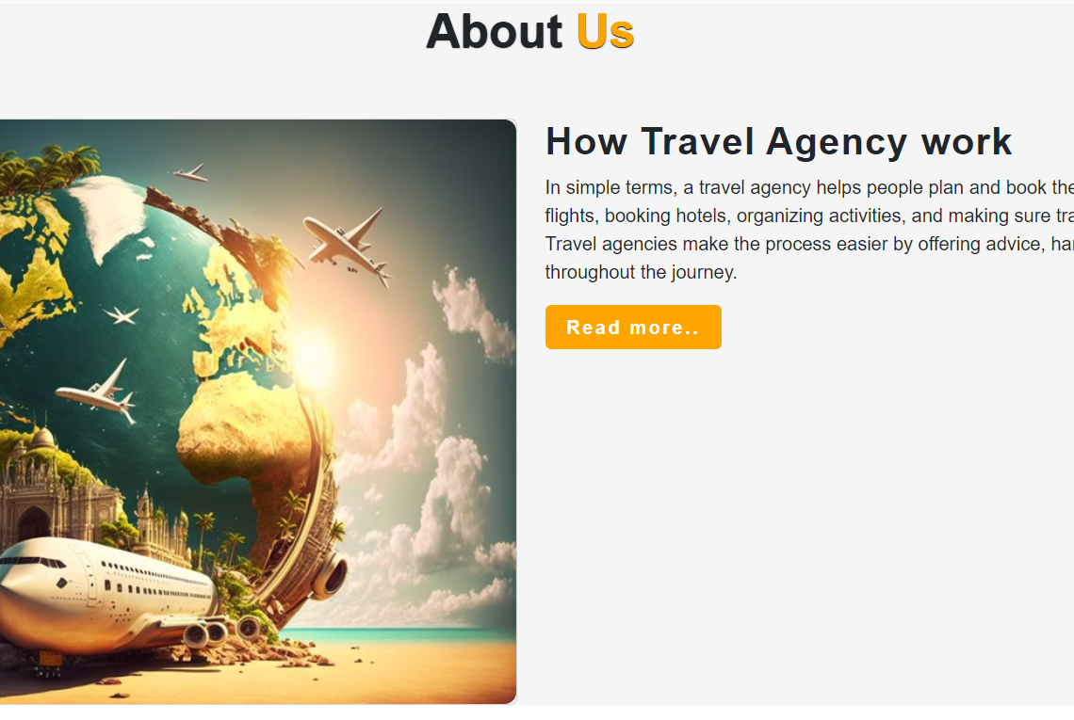
Website Pages

Slide 7




Conclusion
In the rapidly changing landscape of travel, our website stands as a beacon of innovation, catering to the diverse needs of today's globetrotters. With a dynamic and responsive platform, we are not just selling travel; we are facilitating the creation of memories, fostering cultural exchange, and connecting people across borders.

Slide 8
References
W3 SCHOOLS.COM
YOUTUBE.COM
Github.com
WWW.GEEKS FOR GEEKS.COM

Slide 9

Thank you

